Slide 1


Power Query Table Functions Part 5

Slide 2
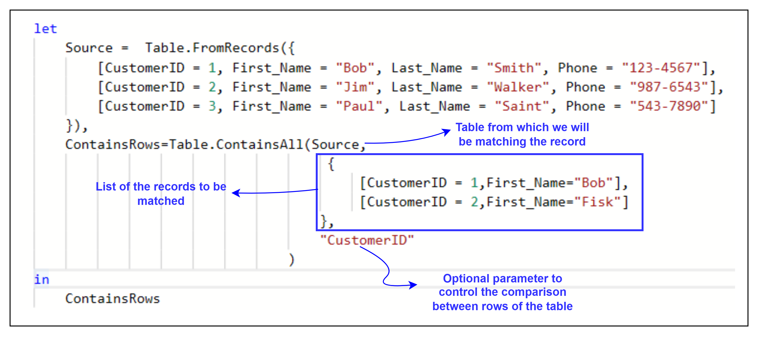
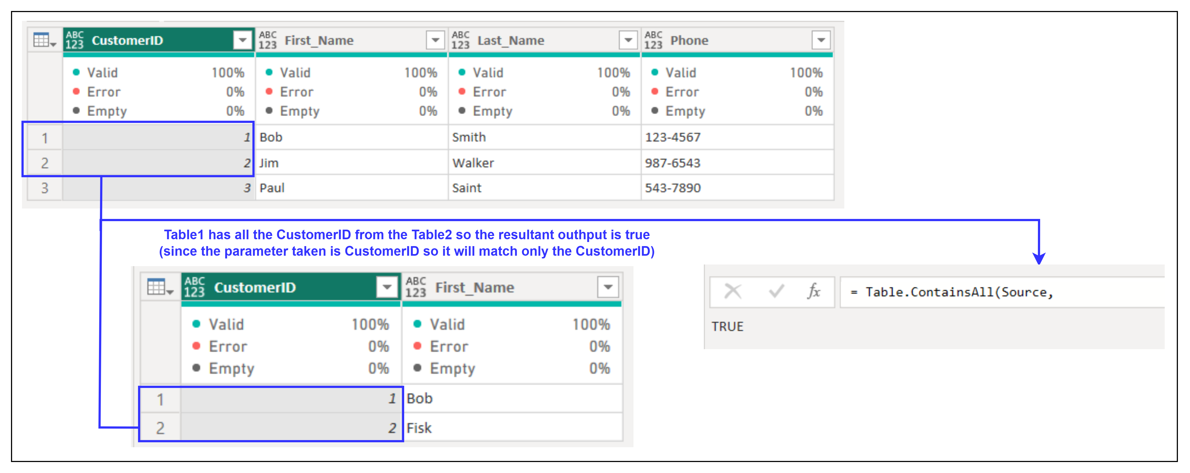
1. Table.ContainsAll
Description: Indicates whether all the specified records in the list of records, appear as rows in the table .
Example:
Result:
Use Cases:
Validating subsets of data.
Ensuring completeness of imported data.

Slide 3
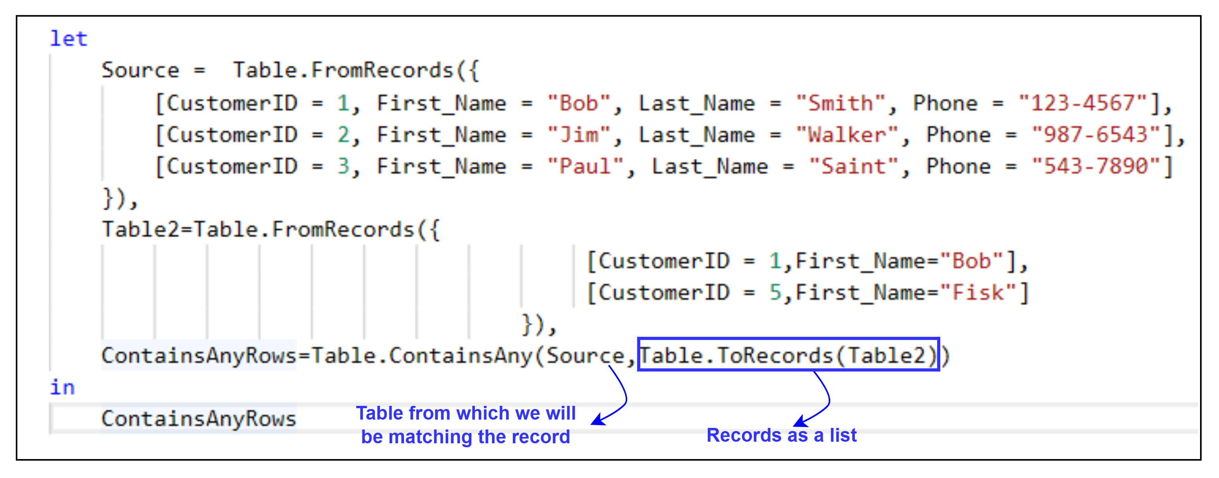
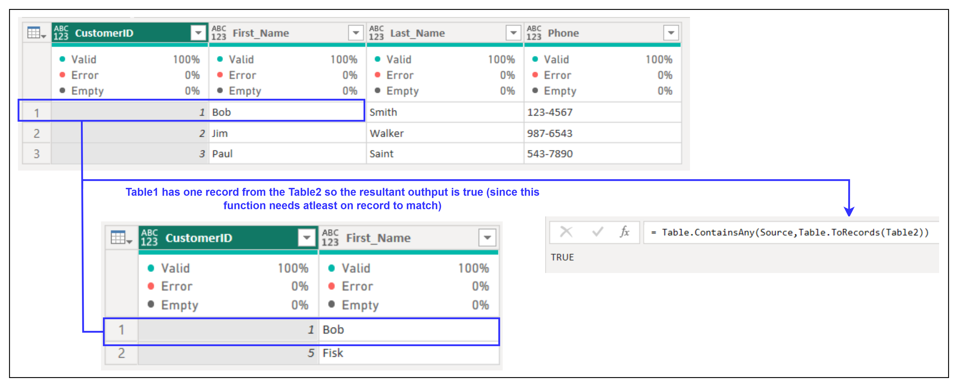
2. Table.ContainsAny
Description: Checks if a table contains any row from another table.
Example:
Result:
Use Cases:
Identifying overlaps between datasets.
Filtering or decision-making based on partial matches.

Slide 4
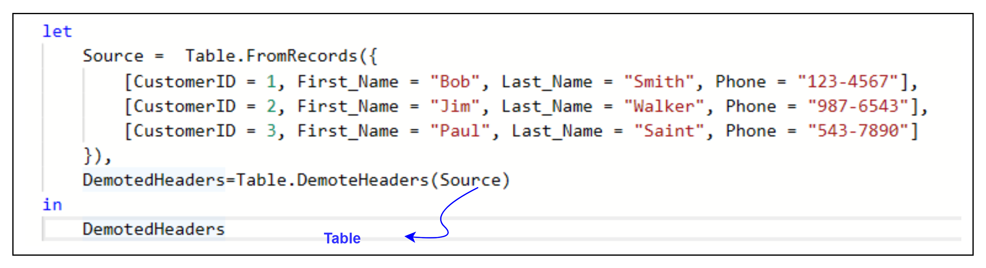
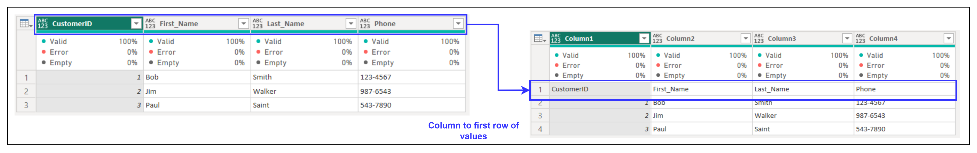
3. Table.DemoteHeaders
Description: Moves the current headers of the table into the first row.
Example:
Result:
Use Cases:
Converting headers to data for transformations.
Preparing data for reorganization or merging.

Slide 5
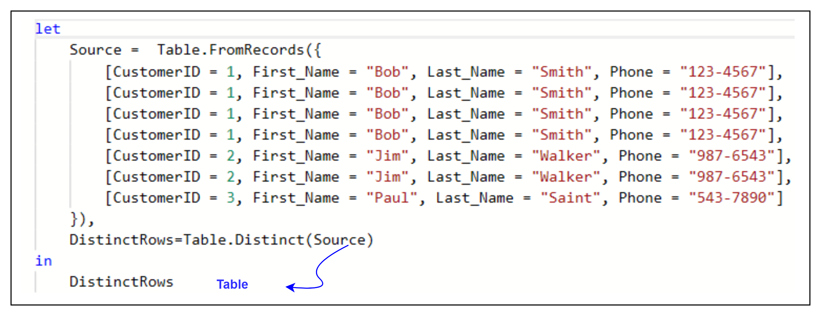
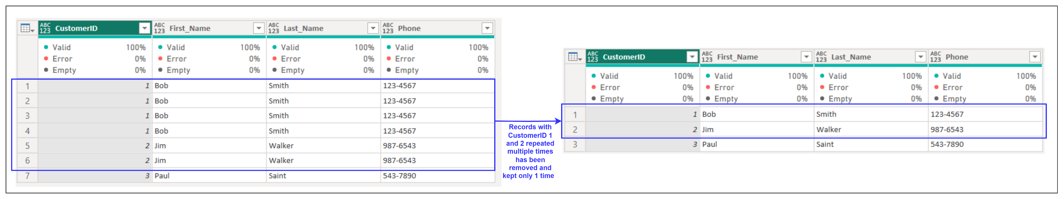
4. Table.Distinct
Description: Returns a table with duplicate rows removed.
Example:
Result:
Use Cases:
Removing duplicate rows from datasets.
Ensuring unique records for aggregation or analysis.

